Slide 1


UDP
PEER TO PEER DATA TRANSFER
Team: Ilomilo

Slide 2


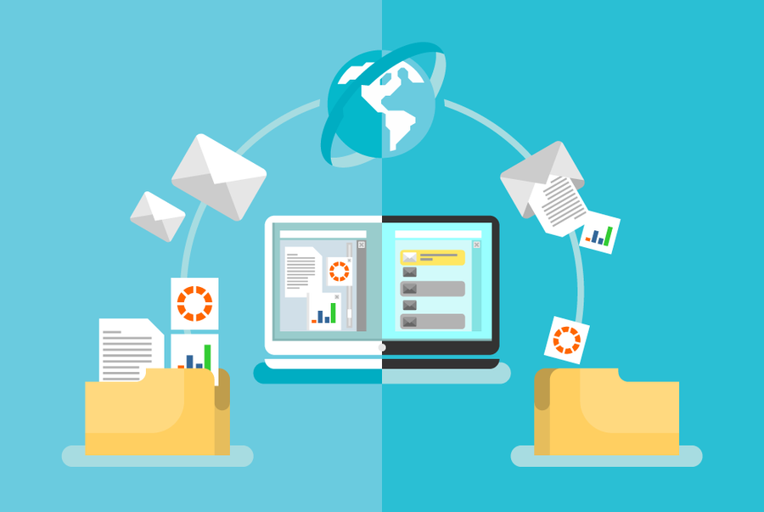
ABOUT PROJECT
Project’s main purpose is to create a software that establishes a secure and efficient peer-to-peer data transfer system between two entities, namely the Data Foundation and the Partner, using the UDP protocol. Despite UDP,the aim is to still make it fast, reliable and most importantly secure by transferring the data directly between the clients without a middleman.

Slide 3

STAKEHOLDER BUY-IN
Movie Industry:
Research Application:
To transfer big movies and videos across different areas in a seamless way which can be used to distribute the big movies quicker to be displayed in theatres
To utilise this platform for the efficient transfer of extensive datasets, such as scientific data or simulations. It can serve as a means of data exchange between different research institutions or among researchers collaborating on a shared project
In terms of stake holder buy-in,the software can be used in the areas where there exists a highly sensitive data which a user wants to safely and directly transfer a heavy data to another user without passing it through the server.
Industrial Utility:
Companies can benefit from this platform for the high-speed transfer of large volumes of data, including sensitive information like financial data or customer records. This can be useful for data sharing among different company divisions or between separate companies.
Educational Use
The software could encompass the exchange of materials like video lectures and research papers among educators and students or among various departments within the same institution.

Slide 4
UDP Protocol
(Enhancing Efficiency)
Parity Check
FUNCTIONAL REQUIREMENTS
Multi-Threading
fastAPI
Hashing
Rooms
Encryption
UI Interface

Slide 5
WORKFLOW ARCHITECTURE
Extracting the parity bit
Checking parity
Unpadding
AES Decryption
Wait for the other packets to get resolved
Enter the Room Number
Process the Info along with user IP and send the details to the server
(IP,PORT,FILENAME )
Information received
Opened the port to receive the data
Sort the packets
File Hashing to finally check the file Integrity
RECEIVERS
No error in during Decryption
User Interface
Fast API
Wait for the Sender’s Info
A few packets are missing or corrupted
Send the packet number to the sender
An Error Exists for a packet
Create a Room with given details
Verify the newly entering receiver details
Wait for all the receivers to join till the room is full
Share all receivers info to the sender
Share the sender’s info to all receivers
FILE SENT SUCCESSFULLY!
SERVER
1
2
N
File Hashing
AES encryption
Padding(changing the size according to the buffer)
Extract Parity and add to all the packets
Sending the data via multi-threading
Room Name
Room Capacity
File Selection
Process the Info along with user IP and send the details to the server
(IP,ROOMNAME,FILENAME,FILESIZE,BUFFERSIZE,PORTNUMBER,N-THREADS,ENCRYPTION KEY)
Information received
Initiating iteration to send to all the IPs mentioned in the list.
Compares the packet number and send those packet back to the Receiver
SENDER
User Interface
Fast API
Wait for receivers to arrive

Slide 6
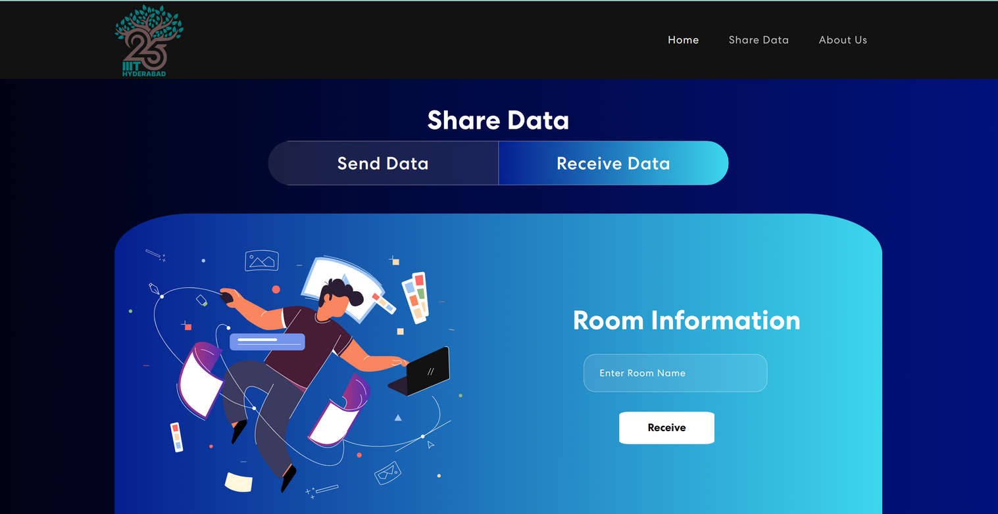
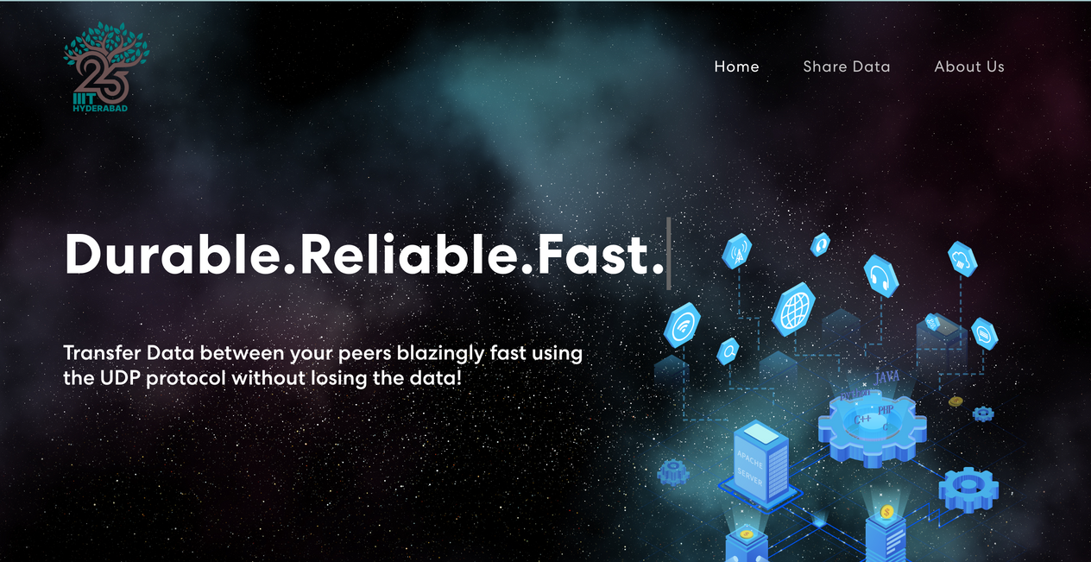
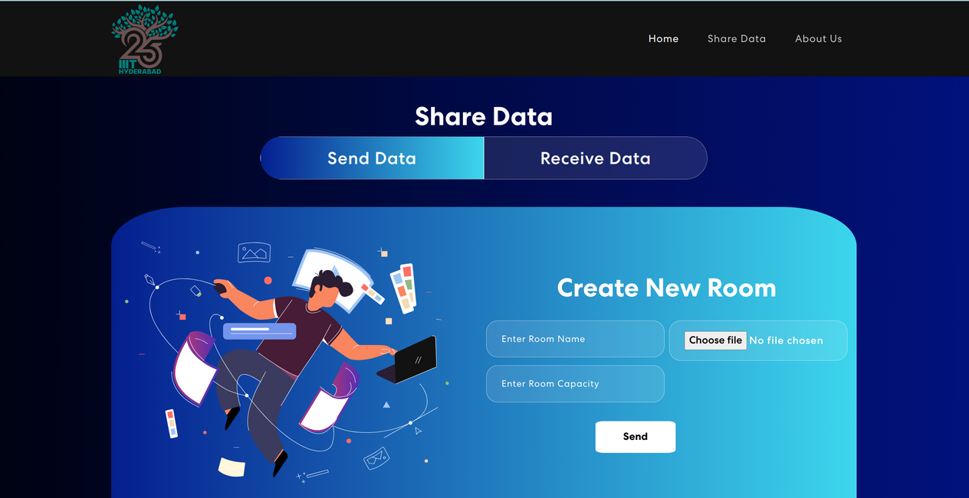
UI DESIGN
We have ensured a dynamic UI that is Elegant yet easy to use for the users

Slide 7
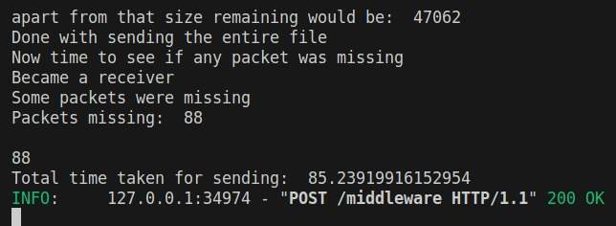
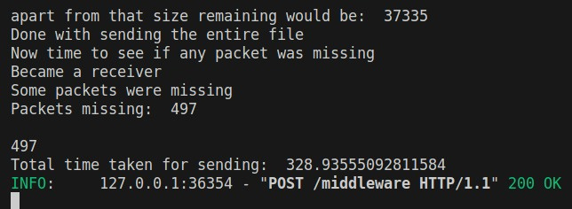
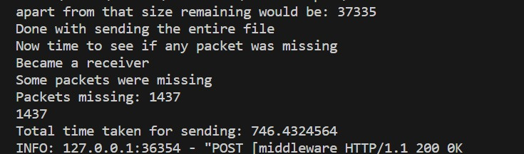
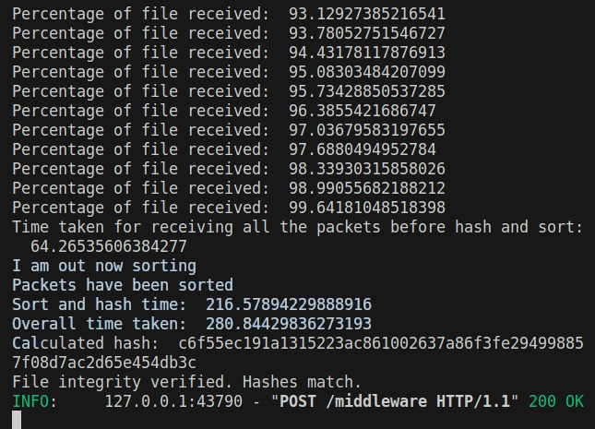
TESTING
190 MB File
750 MB File
1.5GB File

Slide 8
TIMELINE
01
02
03
04
05
AUGUST
SEPTEMBER
OCTOBER MID
END OF OCTOBER
NOVEMBER
Team formation and project allocation
Deploying the previous group’s code, understanding it and converting their TCP to UDP
No response from previous group, scrapped the code and started to write the code from scratch
Frontend coded
UDP transfer code done
Integration of frontend with UDP code
Further Optimizations and fullfillment of the requirements.

Slide 9

CHALLENGES FACED
Figuring out the best valuefor the number of threads and other parameters to makke the packets flow in ease yet fast
The code from the previous group was not well commented/documented which took lot of our time to understand it. The code gave some errors on deploying and we got no response from them regarding this.
Handling the condition in-case some of the packets were missing in the most optimal way
Understanding and coding UDP from scratch took considerable amount of time.
Integration of Frontend with backend gave some errors on WSL.
Handling multiple senders and receivers at a time.

Slide 10
THANK YOU!
Rayaan Khan(2021101120)
Yash Shivhare(2021101105)

